Slide 1
Scrum
ggg.instigatemobile.com

Slide 2
What is Scrum?
Scrum is an iterative agile software development methodology for managing product development
Scrum is an agile process that allows to focus on delivering the highest business value in the shortest time
It allows to rapidly and repeatedly inspect actual working software (every two weeks to one month)
Every two weeks to a month anyone can see real working software and decide to release it as is or continue to enhance it for another sprint
Confidential

Slide 3
Scrum has been used by:
Microsoft
Yahoo
Google
Philips
Siemens
Nokia
BBC
Electronic Arts
High Moon Studios
Lockheed Martin
Capital One
Confidential

Slide 4
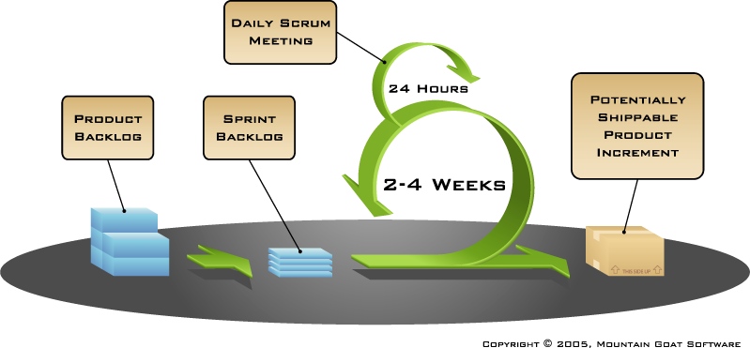
Scrum
Confidential

Slide 5
Sprint
A sprint is a regular, repeatable work cycle in scrum methodology during which work is completed and made ready for review
Scrum projects make progress in a series of “sprints”
Duration is 1–4 weeks
Product is designed, coded, and tested during the sprint
Confidential

Slide 6
All together
Requirements
Design
Scrum team do a little of everything all in a sprint
Code
Test
Confidential

Slide 7

Changes during a sprint
Don't make changes during a current sprint
Think twice before changing a current sprint
Only when customer insists
Confidential

Slide 8
Framework
Roles
Product owner
Scrum Master
Team
Ceremonies
Sprint planning
Sprint review
Sprint retrospective
Daily scrum meeting
Artifacts
Product backlog
Sprint backlog
Burndown chart
Velocity
Confidential

Slide 9
Framework
Roles
Roles
Product owner
Scrum Master
Team
Ceremonies
Sprint planning
Sprint review
Sprint retrospective
Daily scrum meeting
Artifacts
Product backlog
Sprint backlog
Burndown chart
Velocity
Confidential

Slide 10

Product Owner
Identify customer needs and project requirements
Have a full view of the project specifications
Decide on release date and content
Write and have always updated the user stories based on specifications and schedule
Be responsible for sprints backlog
Accept or reject sprint results
Confidential

Slide 11

Scrum Master
Ensures that the scrum process is used as intended
Remove impediments
Enable close cooperation across all roles
Organize and participate in scrum ceremonies
  Sprint planning
  Sprint review (demo)
  Sprint retrospective
  Daily scrum meeting (stand-up)
  Monitor and manage project team to ensure project delivery within allotted budget and timelines
Confidential

Slide 12

Scrum Team
Typically 5-9 people
Cross-functional
  Programmers, testers, designers, etc.
  Members should be full-time
Confidential

Slide 13
Framework
Roles
Product owner
Scrum Master
Team
Ceremonies
Sprint planning
Sprint review
Sprint retrospective
Daily scrum meeting
Artifacts
Product backlog
Sprint backlog
Burndown chart
Velocity
Confidential

Slide 14
Sprint planning
Discuss the scope of work they should implement in that sprint
Prepare the sprint backlog
  Identify the stories/tasks and estimate them (stories not larger than 20 hours/points, tasks not exceed 10 hours/points)
  Write stories' definition of done
  Collaboratively, not done alone by the Scrum Master
build Web application from command line
Product Owner: Add command line tool to build any Web Application
allow to integrate it with Jenkins to have corresponding job
has corresponding README file with description of usage
Confidential

Slide 15
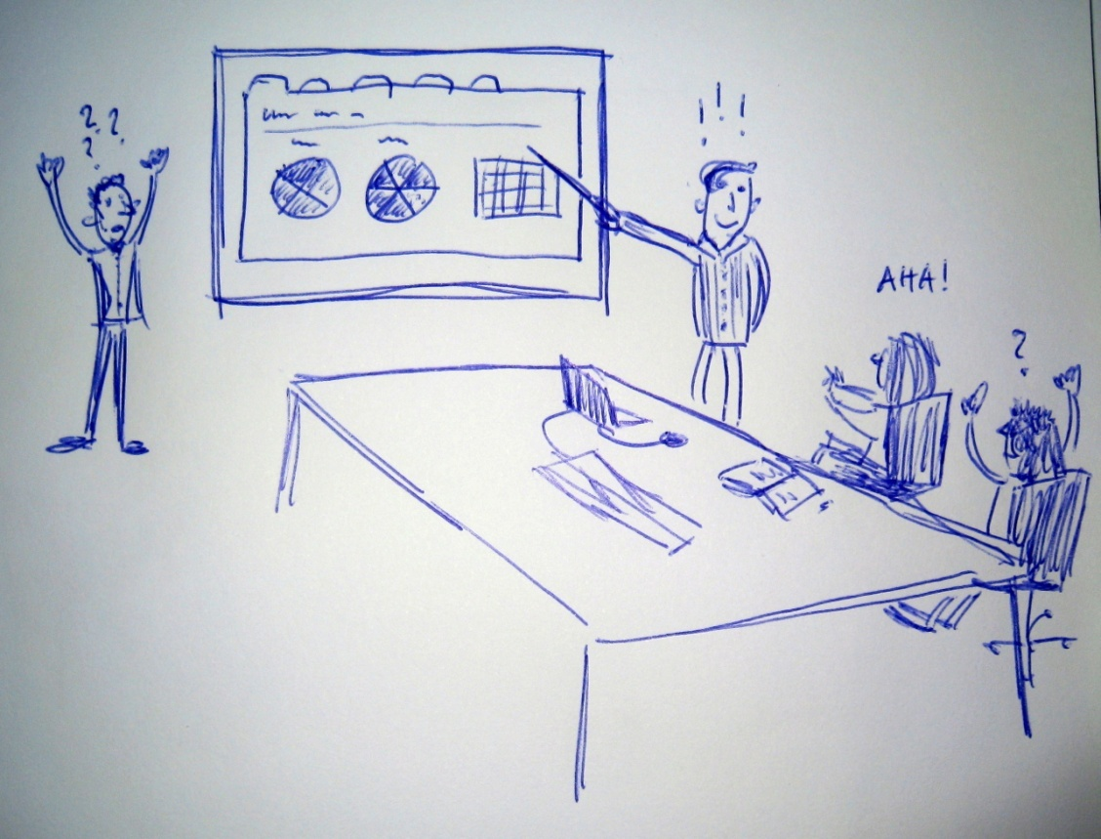
Sprint review (demo)
Team presents what accomplished during the sprint
Informal
Whole team participates
Typically takes the form of a demo of new features
Incomplete work cannot be demonstrated
Confidential

Slide 16

Sprint retrospective
Reflects on the past sprint
Done after every sprint
Whole team participates
Each team-member answers two questions:
  What went well during the sprint?
  What could be improved in the next sprint?
Confidential

Slide 17
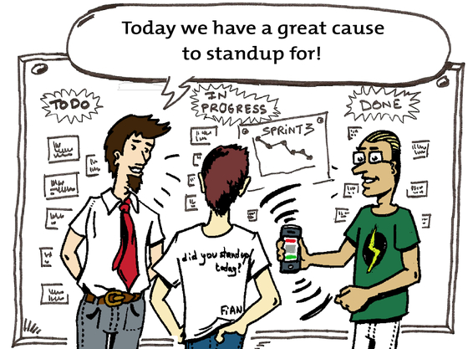
Daily scrum meeting (stand-up)
Parameters
  Daily
  15-minutes
  Stand-up
Not for problem solving
Each team-member answers three questions:
  What did I do yesterday?
  What will I do today?
  Do I see any impediment?
Confidential

Slide 18
Framework
Roles
Product owner
Scrum Master
Team
Ceremonies
Sprint planning
Sprint review
Sprint retrospective
Daily scrum meeting
Artifacts
Product backlog
Sprint backlog
Burndown chart
Velocity
Confidential

Slide 19
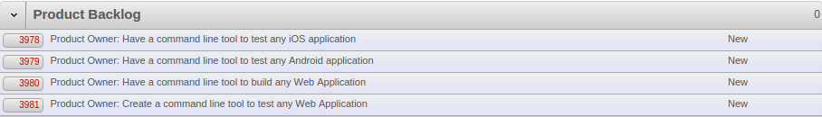
Product backlog
The requirements
A list of all desired work on the project
Prioritized by the product owner
This is the product backlog
Confidential

Slide 20
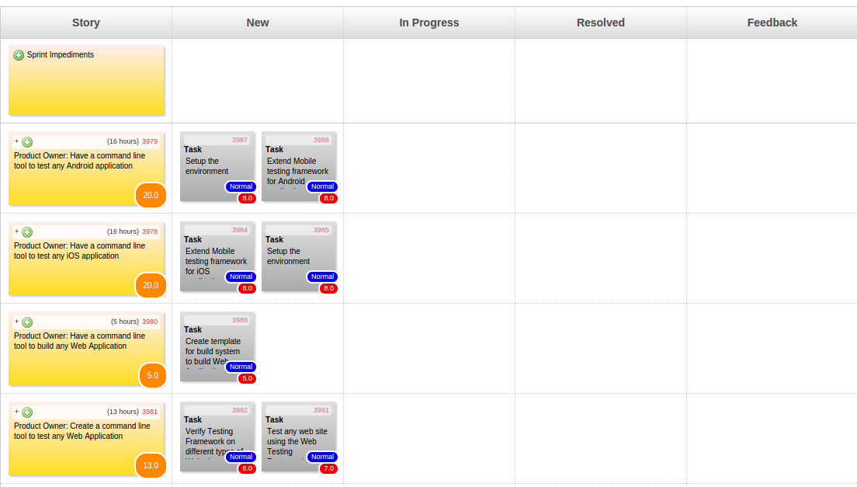
Sprint backlog
A list of tasks identified by the team to be completed during the sprint
Estimated sprint tasks
Remaining work is updated daily
Confidential

Slide 21
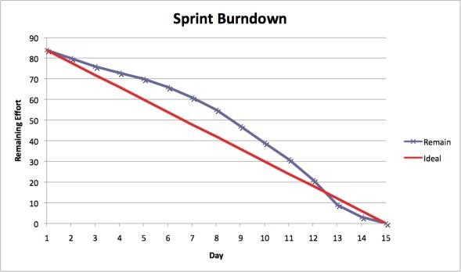
Sprint burndown chart
Confidential

Slide 22
Velocity
A measurement of the work done by the team in the sprint
Measures how much functionality team delivers in the sprint
Estimates the effectiveness of stories/tasks completed by the team
100% completed task is considered done
Helps the team to effectively plan work
All tasks added after planning are not shown in velocity
Confidential

Slide 23
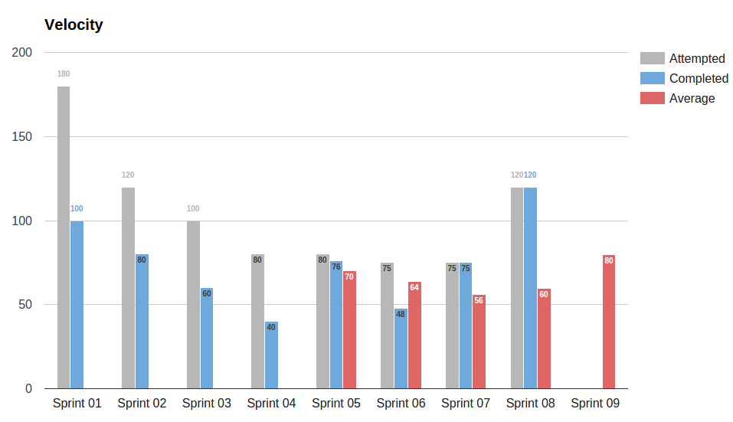
Velocity
Confidential

Slide 24
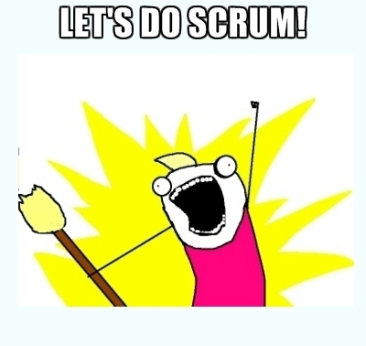
Good luck!
Confidential

Slide 25
Instigate Mobile CJSC
58/1 K. Ulnetsu, Yerevan 0069, Armenia
ggg.instigatemobile.com
Armenia +374 60 464700
USA (VoIP) +1 408 625 7509
Germany (VoIP) +49 893 8157 1771

